Slide 1

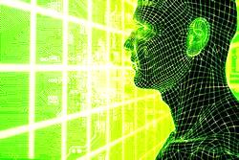
Introduction to Artificial Intelligence
Deep Learning Chapter-2
Artificial Intelligence: A Modern Approach
DENG HAO
E-mail：20139@tongji.edu.cn
Room 408R, School of Software, Tongji University

Slide 2
Introduction
Notes:
1.介绍

Slide 3
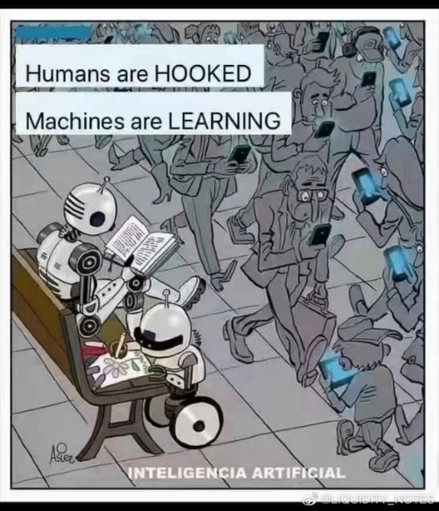
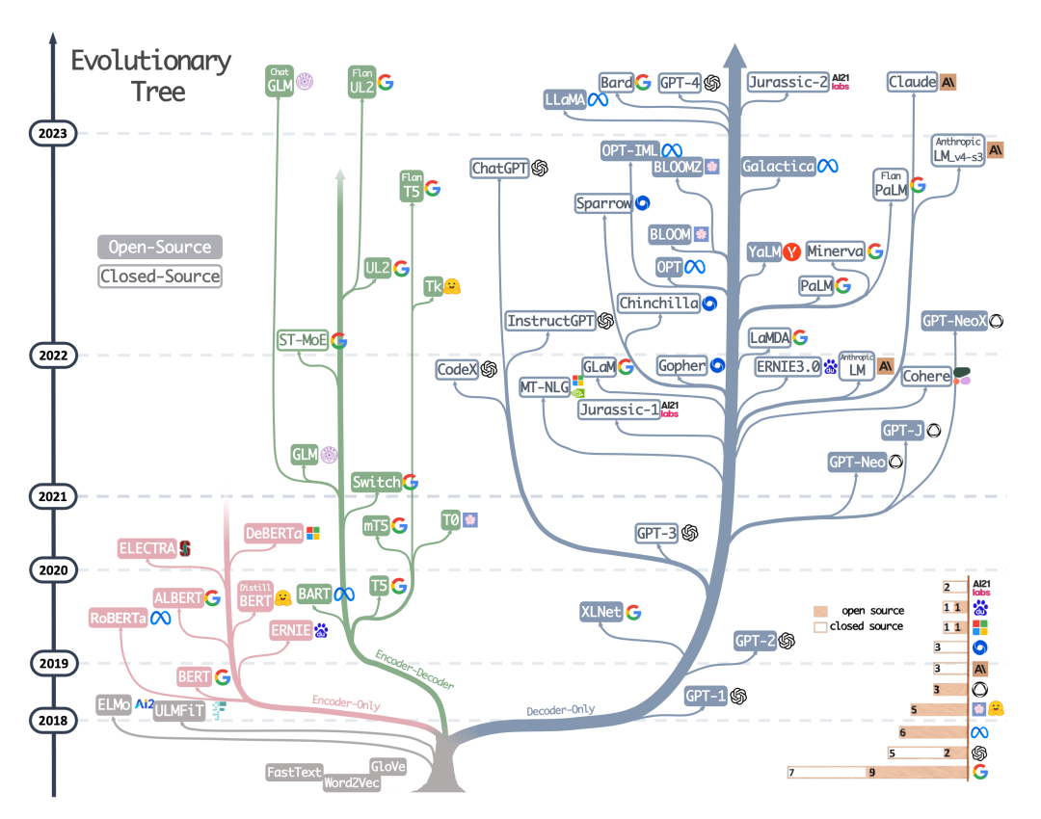
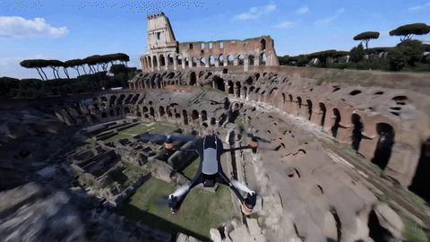
What we talk about when we talk about AI
1、ChatGPT- solve any problem
2、Jasper AI- good at copywriting
3、Synthesia- generate live video
4、Do Not Pay- resolve legal issues
5、Dall-E-2- create artistic works
6、Repurpose IO- automatic social media posting
7、Jenni AI- aid paper writing
8、Tome- write stories
9、Fireflies- make conference notes
10、Murf- generate live speeches
11、Timelt- time management expert
12、Chatbot Live- chat with you
sora
Yang, JF et al., Harnessing the Power of LLMs in Practice: A Survey on ChatGPT and Beyond
https://m.huxiu.com/article/2683137.html?type=text
https://www.qbitai.com/2023/05/50947.html

Slide 4

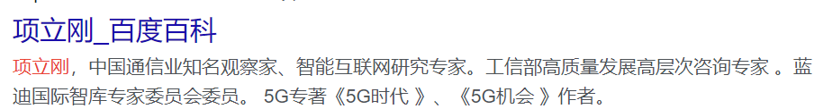
What we talk about when we talk about AI
【Xi Jinping: #Strengthening Basic Research #Consolidate the Foundation of Technological Self-Reliance】On the afternoon of February 21st, the Political Bureau of the CPC Central Committee held its third collective study session on strengthening basic research. General Secretary of the CPC Central Committee Xi Jinping emphasized during the presiding that strengthening basic research is an urgent requirement for achieving high-level technological self-reliance and is the necessary path to building a world-leading science and technology country. More details: http://t.cn/A6CGzL96
China is at the forefront of technology. The core capabilities of science and technology are materials, energy, and information. These capabilities, facilitated by infrastructure development, result in high societal efficiency, strong capabilities, and low costs. Over the past decade, China has surpassed the United States in all areas where they started simultaneously. Furthermore, the manufacturing and infrastructure capabilities developed on this basis far exceed those of the United States. China is the largest trading partner of 140 countries and regions worldwide.

Slide 5

What we talk about when we talk about AI
A very interesting paper: ChatGPT for (Finance) research: The Bananarama Conjecture http://t.cn/A6CbPCSP
The author picked a field and asked ChatGPT to complete four tasks for scientific researchers: 1. Generate new ideas 2. Review existing literature 3. Prepare data 4. Implement ideas and test them
The chosen field is cryptocurrency. They submit the outline generated by ChatGPT to peer reviewers in the field to evaluate the likelihood of the paper being accepted. The results are quite impressive: as long as some guidance is provided during the generation phase, the final result can score 7-8 points. In the words of the original author: all studies have a decent chance of eventual success in the reviewing process in a good finance journal. Interestingly, they found that ChatGPT excels the most in the first task (I thought it would be the second task): generating new ideas. The author says, "This indicates that AI excels at 'broadly thinking about existing concepts and connecting them into a coherent new approach'." (But I think this actually demonstrates a principle that anyone who has done research understands: new ideas lacking in execution are very cheap...
The opinions are very cheap, and almost everyone is willing to share their opinions with you. Many people will present their opinions as facts. You need to distinguish between opinions and facts.

Slide 6
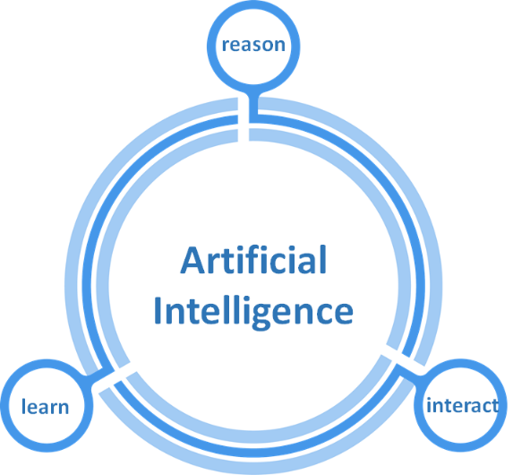
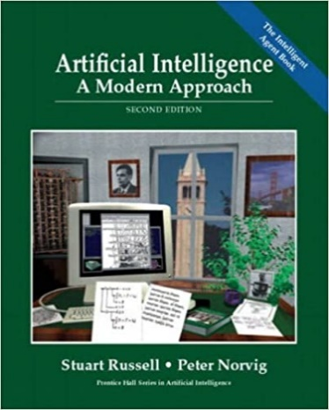
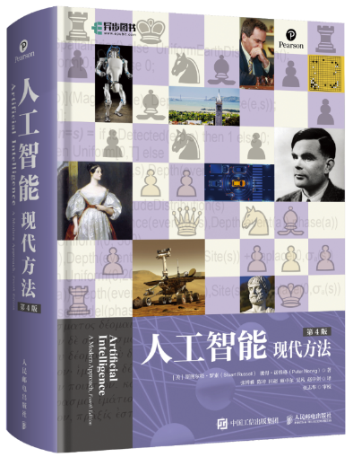
What we talk about when we talk about AI
Virginia Dignum，Member of the World Economic Forum Global AI Council
Problem-solving, knowledge and reasoning, logical actions, uncertain knowledge and reasoning, learning and communication, perception and action
https://medium.com/@virginiadignum/what-we-talk-about-when-we-talk-about-artificial-intelligence-13423a294160
Introduction to the version 4: https://weibo.com/ttarticle/p/show?id=2309404871275821793925
Notes:
什么是⼈⼯智能？
AI的四种定义途径
沿着两个维度排列的AI的定义：
强⼈⼯智能 弱⼈⼯智能
像⼈⼀样思考 合理地思考
像⼈⼀样⾏动 合理地⾏动
历史上对AI的以上4种途径都有⼈关注，不同的⼈⽤不同的⽅法来追寻不同的途径

Slide 7
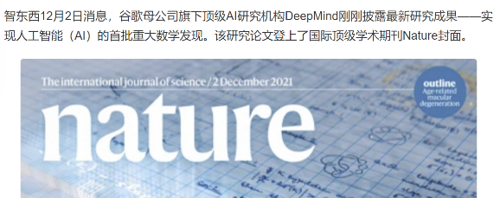
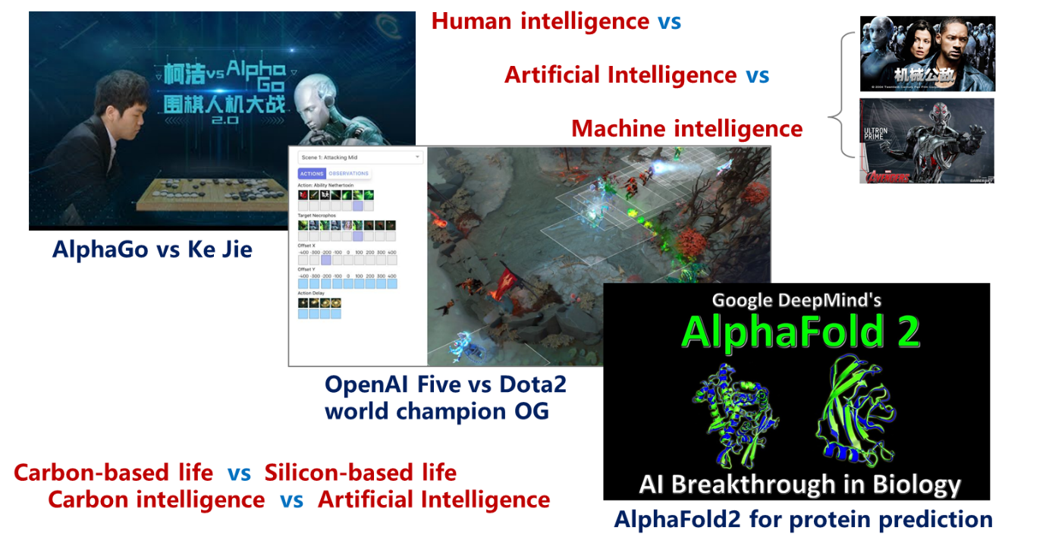

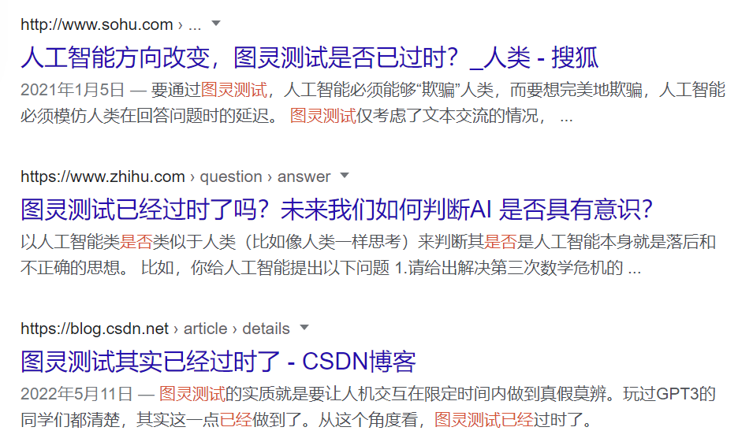
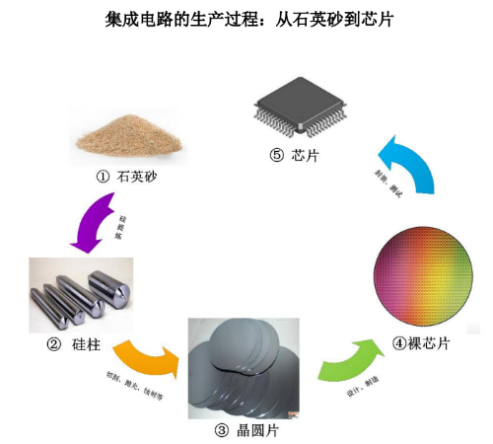

What is artificial intelligence?
20W/day
https://blog.51cto.com/u_15997080/9012628
Notes:
什么是⼈⼯智能？
AI的四种定义途径
沿着两个维度排列的AI的定义：
强⼈⼯智能 弱⼈⼯智能
像⼈⼀样思考 合理地思考
像⼈⼀样⾏动 合理地⾏动
历史上对AI的以上4种途径都有⼈关注，不同的⼈⽤不同的⽅法来追寻不同的途径

Slide 8
What is artificial intelligence?
Four ways of defining AI
Definition of AI arranged along two dimensions.
Strong artificial intelligence
Weak artificial intelligence
Think like a human | Think reasonably
“the exciting new effort to make computers think…. machines with minds, in the full and literal sense” (Haugeland, 1989) “The automation of activities that we associate with human thinking, activities such as decision-making, problem solving, learning ...” (Bellman,. 1978) | “The study of mental faculties through the use of computational models” (Charniak and McDermott, 1985) “The study of the computations that make it possible to perceive, reason, and act” (Winston, 1992)
Thinking humanly
Thinking rationally
Acting humanly
Acting rationally
Act like a human | Act reasonably
“The art of creating machines that perform functions that require intelligence when performed by people” (Kurzweil, 1990) “The study of how to make computers do things at which, at the moment, people are better” (Rich and Knight, 1991) | “Computational Intelligence and Research on the Design of Agents” (Chernick and McDermott, 1985) “AI …. is concerned with intelligent behavior in artifacts” (Nilsson, 1998)
Notes:
什么是⼈⼯智能？
AI的四种定义途径
沿着两个维度排列的AI的定义：
强⼈⼯智能 弱⼈⼯智能
像⼈⼀样思考 合理地思考
像⼈⼀样⾏动 合理地⾏动
历史上对AI的以上4种途径都有⼈关注，不同的⼈⽤不同的⽅法来追寻不同的途径

Slide 9
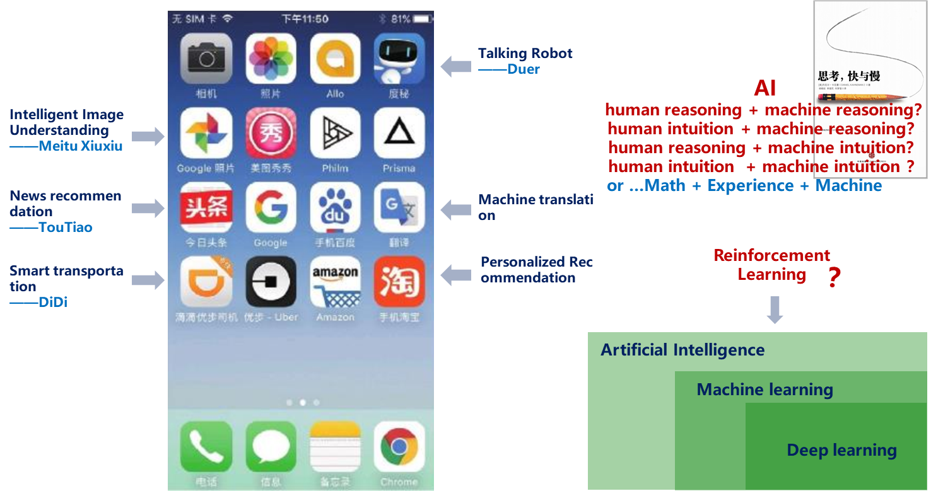
What is artificial intelligence?
Notes:
AI的特征
⼈⼯智能的特征：
1. 由⼈类设计，为⼈类服务，本质为计算，基础为数据；
2. 能感知环境，能产⽣反应，能与⼈交互，能与⼈互补；
3. 有适应特性，有学习能⼒，有演化迭代，有连接扩展；

Slide 10
What is artificial intelligence?
Characteristics of AI
The characteristics of artificial intelligence.
ONE
TWO
THREE
Designed by people, works for people, with the essence of computing and the foundation of data.
The ability to perceive the environment, to respond, to interact with and to complement the human.
Adaptive properties, learning capability, evolutionary iterations, and connected extensions.
Notes:
AI的特征
⼈⼯智能的特征：
1. 由⼈类设计，为⼈类服务，本质为计算，基础为数据；
2. 能感知环境，能产⽣反应，能与⼈交互，能与⼈互补；
3. 有适应特性，有学习能⼒，有演化迭代，有连接扩展；

Slide 11
What is artificial intelligence?
Argument on AI
Symbolism
Symbolism is also known as logicalism, psychologism or computerism. It originated in mathematical logic.
Principles of symbolism: the assumption of a physical symbol system (i.e., symbolic operating system) and the principle of limit reasonability
Representatives are Newell, Shaw, Simon and Nelson
Connectionism
Connectionism is also known as the bionicsism, or physiologism. It originated from the study of mimicry, especially the model of the human brain.
The principles of connectionism: neural network(NN) and connectionism and learning algorithm between NN.
Actionism
Known as evolutionism or the cyberneticsism.
The principles of Actionism: cybernetics and control principle of perception action.
Wiener and McCulloch, Qian Xuesen
Notes:
人工智能主要分为以下三个流派：
一是符号主义，又称逻辑主义、⼼理学派或计算机学派。起源于数理逻辑。符号主义的原理是物理符号系统(即符号操作系统)假设和有限合理性原理；
其次是连接主义，又称仿⽣学派或⽣理学派。起源于仿⽣学，特别是⼈脑模型的研究。连接主义的原理是神经⽹络及神经⽹络间的连接机制与学习算法；
最后是⾏为主义，又称进化主义或控制论学派。起源于控制论。⾏为主义的原理是控制论及感知—动作型控制系统。
【5】

Slide 12
Intelligent Agent
Notes:
智能化智能体

Slide 13
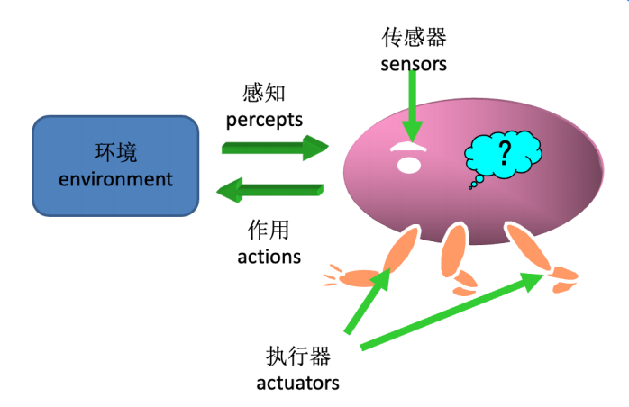
Intelligent agent
Basic Concept
Concept: An intelligent agent is something (thing) that perceives its environment through sensors and acts on that environment through actuators.
Interaction of the intelligent agent with the environment
Examples.
Passive agents or goal-less agents (such as objects in simple simulations)
Agents with simple goals (such as birds in a flock)
Cognitive agents (with complex computation)
Notes:
基本概念
概念：智能体是通过传感器感知所处环境并通过执⾏器对该环境产⽣作⽤的东西（事物）
【智能体与环境的交互作⽤】
举例：
1. ⼈类智能体
2. 机器⼈智能体
3.⾃动驾驶汽车

Slide 14
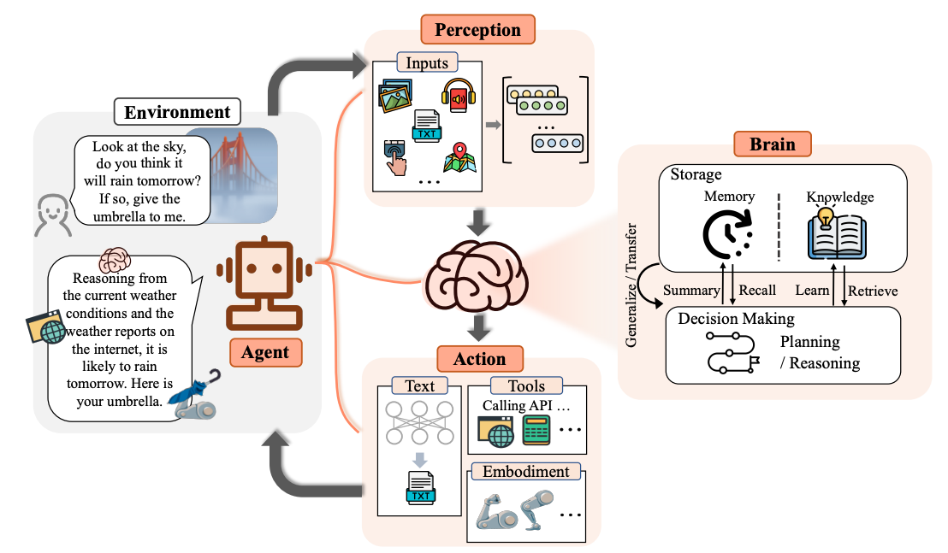
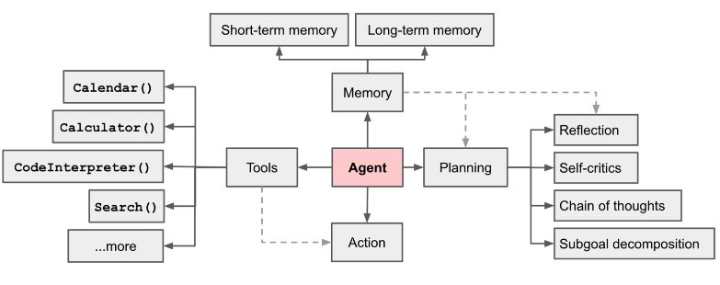
Intelligent agent
The Rise and Potential of Large Language Model Based Agents: A Survey
AI Agents based on large language models (LLMs)
https://www.youtube.com/watch?v=qpJl1IOx4-w
Notes:
基本概念
概念：智能体是通过传感器感知所处环境并通过执⾏器对该环境产⽣作⽤的东西（事物）
【智能体与环境的交互作⽤】
举例：
1. ⼈类智能体
2. 机器⼈智能体
3.⾃动驾驶汽车

Slide 15
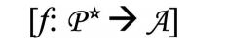
Intelligent agent
Definition
Given a perceptual sequence - find the FWI, this can be achieved by means of an intelligent agent function, abstractly expressed mathematically as
Instead, smartagent functions are implemented by specific smartagent programs that operate on the smartagent's own architecture. In summary, an intelligent agent can be defined as: Intelligent agent = Architecture + Program
Notes:
给定感知序列——求取⾏动，这可以通过智能体函数来实现，抽象的数学表⽰为：
⽽智能体函数通过具体的智能体程序来实现，并在智能体⾃⾝的结构上运⾏。
总的来说，可以把智能体定义为：智能体 = 体系结构 + 程序

Slide 16
Rational agents
Definition
For each possible perceptual sequence, based on the evidence provided by the known perceptual sequences and the a priori knowledge the intelligence has, the rational intelligence should choose the sequence that is expected to The action that maximizes its performance metric.
The difference between Rational and Omniscience
1. Rational ≠ Omniscient
An omniscient intelligence knows exactly the actual outcome of its actions and acts accordingly,
which is not possible in reality. Rationality does not require omniscience. Rational choice depends
only on the sequence of perceptions up to that point in time.
2. Rational ≠ Perfect
Rationality is maximizing the desired performance
Perfection is maximizing the actual performance
Perfection is not a reasonable requirement for an intelligent agent.
Notes:
理性智能体
定义
对每⼀个可能的感知序列，根据已知的感知序列提供的证据和智能体具有的先验知识，理性智能体应该选择期望能
使其性能度量最⼤化的⾏动。
理性（Rational）与全知（Omniscience）的区别
1. 理性 ≠ 全知
⼀个全知的智能体明确的知道它的⾏动产⽣的实际结果并且做出相应的动作，全知者在现实中是不可能的。
理性并不要求全知。理性的选择只依赖于到当时为⽌的感知序列。
2. 理性 ≠ 完美
理性是使期望的性能最⼤化 完美是使实际的性能最⼤化
对智能体⽽⾔，完美是不太合理的要求

Slide 17
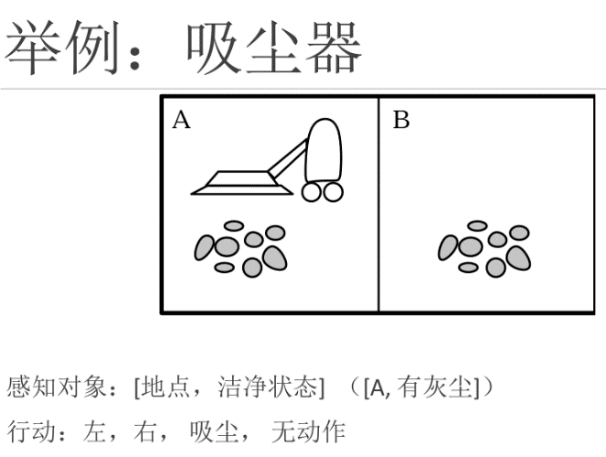
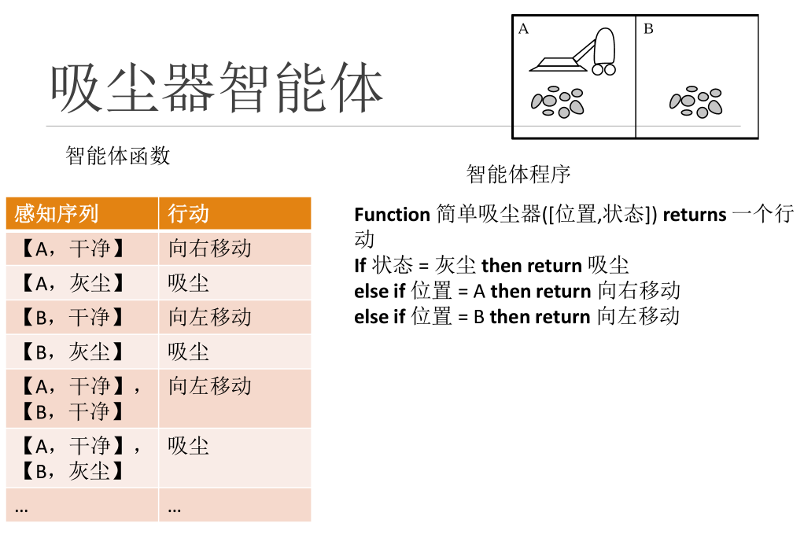
Intelligent agent
Performance measure
Environment
Actuators
Sensors

Slide 18
Search

Slide 19
Search Question Guides and Formalizations
One problem arises that our agents need to search or solve towards goals. This is particularly what 'goal-based agents' focus on. We refer to them as Problem-Solving Agents."
Formalization
A formal description of a problem usually consists of five parts. These are initial state, action, transfer model, destination test, and path dissipation.
Uninformed search
The first discussion is about the search algorithm with no information. Uninformed search is also
called blind search. It refers to the absence of any information other than the state information provided
in the problem definition. What search algorithms do is to create successor states and distinguish
between target states and non-target states
Informed (Heuristic )search
If you can find a search method that can make full use of some characteristics of the problem to be solved to guide the search towards the most conducive to solving the problem, then the efficiency of the search will be greatly improved. Here is a heuristic search, also known as an informed search strategy.
Notes:
形式化
形式化描述⼀个问题通常包括5个部分。分别为初始状态，⾏动，转移模型，⽬标测试和路径耗散
⽆信息搜索
⾸先讨论的是⽆信息的搜索算法。⽆信息搜索也称为盲⽬搜索。是指除了问题定义中提供的状态信息外没有任何其
他信息。搜索算法要做的是⽣成后继状态并区分⽬标状态与⾮⽬标状态，⽆信息搜索⼀般分为以下⼏类：宽度优先
搜索，⼀致代价搜索，深度优先搜索，深度受限搜索，迭代加深的深度优先搜索，双向搜索
有信息搜索
如果能找到⼀种搜索⽅法，能够充分利⽤待求解问题⾃⾝的某些特性信息，以指导搜索朝着最有利于问题求
解的⽅向发展，那么搜索的效率就会⼤⼤提⾼。在这⾥就要⽤到启发式搜索了，也称为有信息搜索策略。

Slide 20
Logical agents
Notes:
逻辑智能体

Slide 21
Knowledge-based agents
A story
This part emphasizes "utilizing logic as a universal representation to support knowledge-based agents". In this way, agents can adapt to various purposes by combining and recombining information.
Your roommate is back in the dorm room and he/she is soaked to the skin. You know the following things.
1. Your roommate is wet on his loin
2. If your roommate is wet, either because of the rain or sprinklers
3. If your roommate was wet by a sprinkler, then the sprinkler must be running!
4. If your roommate is drenched by the rain, then he/she must not have brought an umbrella
5. The umbrella is not on the umbrella stand
6. If the umbrella is not on the umbrella stand, then either you took the umbrella, or your roommate took the
umbrella
7. You don't have an umbrella.
Reflections
1. Can you deduce whether the sprinkler is running or not?
2. Can AI deduce whether a sprinkler is running or not?
Notes:
标：知识的逻辑表⽰和推理
⼀个故事
你的室友回到了寝室，他/她⾝上湿透了。你知道以下⼏件事：
1. 你的室友⾝上湿了
2. 如果你的室友⾝上湿了，要么是因为下⾬，要么是洒⽔车
3. 如果你的室友是被洒⽔车弄湿了，那么洒⽔车⼀定正在运⾏
4. 如果你的室友是被⾬淋湿了，那么他/她⼀定没带伞
5. 伞不在伞架上
6. 如果伞不在伞架上，那么要么是你拿了伞，要么是你室友拿了伞
7. 你没有拿伞
思考
1. 你能推断出洒⽔车是否在运⾏吗？
2. ⼈⼯智能能推断出洒⽔车是否在运⾏吗？

Slide 22
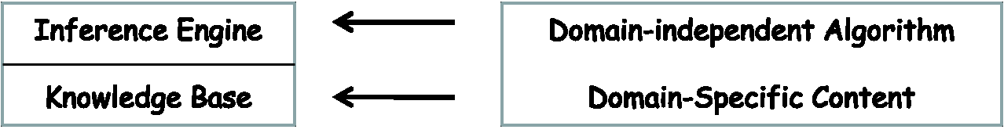
Knowledge-based agents
Knowledge base of stories
1. Roommate is wet
2. Roommate is wet => (Roommate is wet by the rain OR Roommate is wet by the sprinkler)
3. The roommate was wet by the sprinkler => the sprinkler was running
4. Roommate is wet by the rain => NOT (roommate took the umbrella)
5. The umbrella is missing
6. The umbrella is missing => (You took the umbrella OR your roommate took the umbrella)
7. NOT(You took the umbrella)
Knowledge-based agents
Knowledge base = a collection of sentences composed of formal language
断言 公理
Notes:
故事的知识库
1. 室友湿了
2. 室友湿了=> (室友是被⾬淋湿的 OR 室友是被洒⽔车淋湿的)
3. 室友是被洒⽔车淋湿的=>洒⽔车在运⾏
4. 室友是被⾬淋湿的=>NOT(室友拿了伞)
5. 伞不见了
6. 伞不见了=> (你拿了伞 OR 室友拿了伞)
7. NOT(你拿了伞)
基于知识的智能体
知识库 = 由形式语⾔组成的句⼦集合

Slide 23
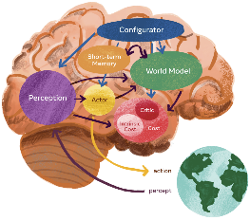

Logical Representation and Reasoning of Knowledge
What is logic?
Logic is a formal system used to process facts with the goal of reaching correct conclusions.
grammar is a rule for constructing valid clauses for the knowledge base: for example, x + 2 ≥ y is a valid
arithmetic statement, ≥x2y + is not.
Semantics is the "meaning" of a sentence, or the relationship between a logical statement and the real world;
specifically, semantics determines the truth or falsity of a sentence, e.g., x + 2 ≥ y
When true, we can take x = 5 and y = 7
Models
Logicians usually think in terms of models, which are formalized structural worlds that can be evaluated for truth or falsity (人工智能现代方法 p169)
Is Sora poised to become a 'world model'?
Three challenges in artificial intelligence research:
1. How machines learn to represent the world, learn to predict, and learn to act primarily through observation?
2. How machines can reason and plan in a manner compatible with gradient-based learning?
3. How machines can learn to represent perception and action planning in a hierarchical manner across multiple abstract levels and multiple time scales
Turing Award winner Yann LeCun: The ability to learn "world models" is the key to building human-level AI
Notes:
标题：知识的逻辑表⽰和推理
1.什么是逻辑？
逻辑是⼀个⽤来处理事实的形式化系统，⽬的是得到正确的结论；
语法是构造知识库有效句⼦的规则：例如, x + 2 ≥ y 是有效的算术语句, ≥x2y + 就不是；
语义是句⼦的“含义”, 或者逻辑语句和真实世界之间的关系，具体⽽⾔，语义决定了句⼦的真假，例如，x + 2 ≥ y
为真时可以取x = 5 且y = 7
2.模型
逻辑学家通常根据模型来思考，这些模型是可以评估真假的形式化的结构世界。
如果α 在m中为真，我们说m是句⼦α 的模型；M(α) 是所有α的模型的集合；那么 KB ╞ α iff M(KB) M(α)。例如， KB = 巨⼈队赢了and 红队赢了; α = 巨⼈队赢了

Slide 24
Propositional logic: a simple logic
Assignment
A proposition is a statement that can be judged as true or false. There are only two possible judgments
of such a statement: one is a correct judgment and the other is an incorrect judgment. The truth value
(or value) of a proposition that is judged to be correct is true, and the truth value (or value) of a
proposition that is judged to be incorrect is false. Thus, a proposition can be called a statement with a
unique truth value or a statement with a unique judgment result
01
The truth value of a proposition: the result of a judgment
02
The value of the true value: both true and false
03
True proposition: the true value is the true proposition
04
False proposition: a proposition whose true value is false
Notes:
标：命题逻辑：⼀种简单的逻辑
命题是能判断真假的陈述句。这种陈述句的判断只有两种可能：⼀种是 正确的判断，⼀种是错误的判断。称判断
为正确的命题的真值（或 值）为真，称判断为错误的命题的真值（或值）为假。因此又可称命题是具有唯⼀真值
的陈述句或判断结果惟⼀的陈述句
1.命题的真值：判断的结果
真值的取值：真与假 ⼆者取⼀
真命题：真值为真的命题
4.假命题：真值为假的命题

Slide 25
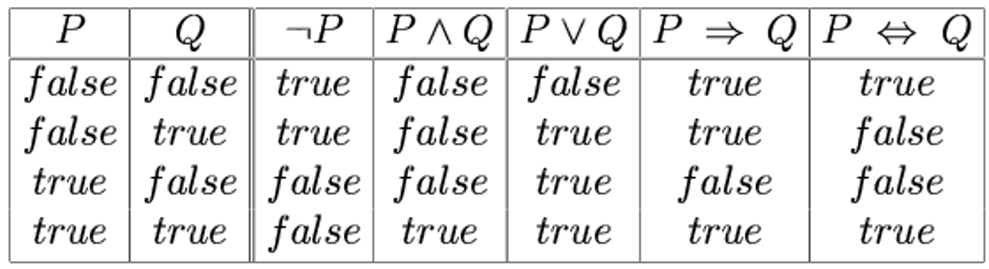
Logical Representation and Reasoning of Knowledge
Classification of Propositions
Simple proposition (original subordinate proposition): a proposition consisting of a simple declarative sentence
Compound proposition: A proposition formed by linking simple propositions using conjunctions
A truth table of connectives
Notes:
1.命题的分类
简单命题（原⼦命题）：简单陈述句构成的命题
复合命题：由简单命题⽤联结词联结⽽成的命题
2.命题逻辑：语法
原⼦语句：⼀个命题逻辑符号表⽰⼀个真或假的状态
取⾮：如果P是⼀个语句，那么他也是⼀个语句
析取：如果P和Q都是语句，那么它们 也是语句
合取：如果P和Q都是语句，那么 也是语句

Slide 26
First order logic
Notes:
⼀阶逻辑推理

Slide 27
First order logical reasoning
Limitations of propositional logic
The reason for this limitation is that propositional logic does not take into account the intrinsic connections and quantitative relationships between propositions. To reflect this intrinsic connection, we need to analyze propositional logic, analyze the individual words, predicates, and quantifiers in it, and then study the logical relationships among them to summarize the correct forms and rules of reasoning, which is the study of first-order (predicate) logic.
Notes:
命题逻辑的局限性
产⽣局限性的原因来⾃于命题逻辑不考虑命题之间的内在联系和数量关 系。 要反映这种内在联系，就要对命题逻
辑进⾏分析, 分析出其中的个体词、谓词和量词，再研究它们之 间的逻辑关系，总结出正确的推理形式和规则，这 就是⼀阶(谓词)逻辑的研究内容。
解决问题的办法是将命题再次细分

Slide 28
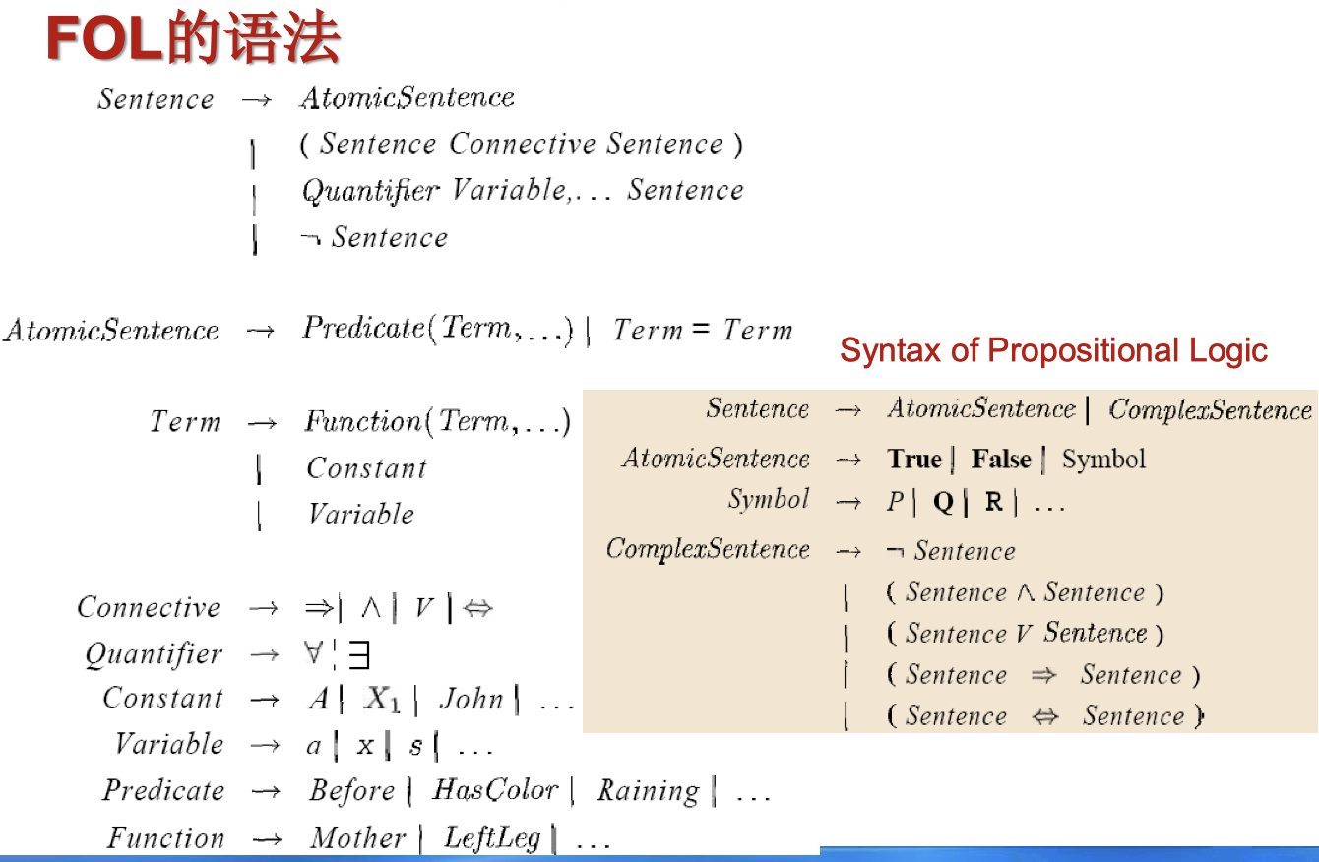
First Order Logic
The elements of first-order logic include: objects, relationships, functions, and equivalence
Basic elements of FOL syntax: constants, predicates, functions, variables, connectors, and other words, and quantifiers
Atomic statement=predicate(term1,…,termx) or term1 = term2
term=function(term1,…,termx) or constant or variable
Complex statements are composed of atomic statements connected by connectives and quantifiers
The grammar of FOL
Notes:
标：⼀阶逻辑（First Order Logic, FOL）
⼀阶逻辑的元素有：对象、关系、函数、等价性
FOL语法的基本元素：常量、谓词、函数、变量、连接符、等词、量词
原⼦语句=predicate(term1,…,termx) or term1 = term2
术语=function(term1,…,termx) or constant or variable
复杂语句是由原⼦语句通过连接词和量词连接组成的

Slide 29
Quantifying Uncertainty
Notes:
不确定性量化

Slide 30
Uncertainty Overview
In an environment where the intelligent agent's observations may be partially observable or uncertain, the agent needs to deal with uncertainty. However, in uncertain environments, it difficult for intelligent agent to predict its state or position after a series of actions.
Traditional solutions rely on "representations of the set of all possible world states" (called belief states) and "generating contingency plans" to address uncertainty issues. But they have many shortcomings when used to create Agent programs:
1) Considering every logically possible interpretation; 2) Considering every possible scenario; 3) Comparing action plans that cannot achieve the goal
An Example of Uncertainty: Autonomous Taxi Intelligent agent
Purpose: Delivering passengers to the airport on time
Planning: At = departing t minutes before the plane's departure and driving to the airport at a reasonable speed.
Question: Can At planning get passengers to the airport on time?
Environment:
1. Partially observable (road conditions, other driver planning, etc.)
2. Uncertainty (vehicle flat tire, engine failure, etc.)
A logical intelligence may give the conclusion that
1. Risky leniency: "Planning A90 will get us to the airport in time"
2. To come to the following weaker conclusion: "Planning A90 will get us to the airport in time, as long
as the car doesn't break down, we don't run out of gas, we don't encounter any traffic accidents,
there are no traffic accidents on the bridge, the plane doesn't take off early, and there are no
meteors hitting my car, ...... "
Notes:
不确定性概述
⼀个不确定性的例⼦：⾃动驾驶出租车智能体
⽬标：将乘客按时送到机场 规划：At = 在飞机起飞t分钟前出发，并以合理的速度驶向机场。
问题：At规划能使乘客准时到达机场吗？
环境:
1. 部分可观测的 (路况, 其它驾驶员规划, etc.)
2. 不确定性(车辆爆胎, 引擎失灵, etc.)
⼀个逻辑智能体可能给出的结论：
1. 有风险的断⾔: “规划A90 将使我们及时到达机场”
2. 得出如下的弱⼀些的结论:“规划A90将使我们及时到达机场，只要车不抛锚，汽油不耗尽，不遇到任何交通事
故，桥上也没有交通事故，飞机不会提前起飞，⽽且没有陨星砸到我的车，……”

Slide 31
Uncertainty and Rational Decision Making
Approach to Uncertainty
In an uncertain environment, the knowledge of the intelligence provides the degree of belief of the relevant statements, and the main tool for dealing with the degree of belief is probability theory. Probability provides a way to generalize the uncertainty created by our inertia and ignorance:
the probability (likelihood) that planning A25 will get us to the airport in time is 0.04
01
Probability theory: a theory used to handle the belief degree
02
Utility theory: The representation and reasoning about preferences is a measure of validity
03
Decision theory = probability theory + utility theory
Basic idea: An agent is rational, if and only if it selects the action that produces the highest expected utility move about
Notes:
标：不确定性与理性决策
处理不确定性的⽅法
不确定环境下，智能体的知识提供相关语句的信念度(degree of belief)，处理信念度的主要⼯具是概率理论
(probability theory )。概率提供了⼀种⽅法以概括由我们的惰性和⽆知产⽣的不确定性：规划A25将使我们及时到
达机场的概率(可能性)是0.04
概率论： ⽤于处理信念度的理论 效⽤理论：对偏好进⾏表⽰和推理，是有效性的度量
决策理论 = 概率理论 + 效⽤理论
基本思想：⼀个智能体是理性的，当且仅当它选择能产⽣最⾼期望效⽤(Maximum Expected Utility, MEU)的
⾏动

Slide 32
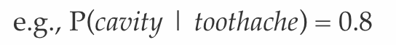
Prior probability, Posterior probability
What is probability about?
Like logical assertions, probability assertions are assertions about possible worlds. Logical assertions consider which possible worlds are strictly excluded (eliminating all those worlds where the assertion is false), while probability assertions consider how likely various possible worlds are.
When a probability assertion provides constraints on the underlying probability model without having a fully determined probability model, such probabilities are called unconditional probabilities or prior probabilities. They refer to the degree of belief in propositions without knowing other information.
In most cases, we have some information already know, called evidence. For example, if we have already observed one die showing a 5 while waiting for the second die to stop rolling. In this situation, we are no longer concerned with the prior probability of obtaining the same number 5, but rather with the probability of obtaining the same result for both dice given that the first die shows a 5. Such probabilities are called conditional probabilities or posterior probabilities.
Prior probability refers to the probability obtained based on previous experience and analysis;
Posterior probability refers to the probability of event A occurring when another event B has already occurred.
Notes:
需要修改
先验概率（prior probability）是指根据以往经验和分析得到的概率
后验概率是指事件A在另外一个事件B已经发生条件下的发生概率。e.g., P(cavity | toothache) = 0.8

Slide 33
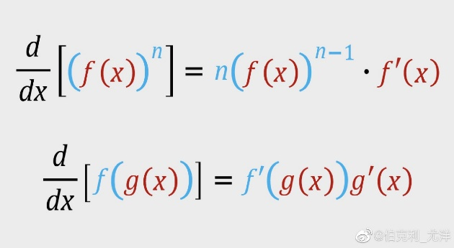
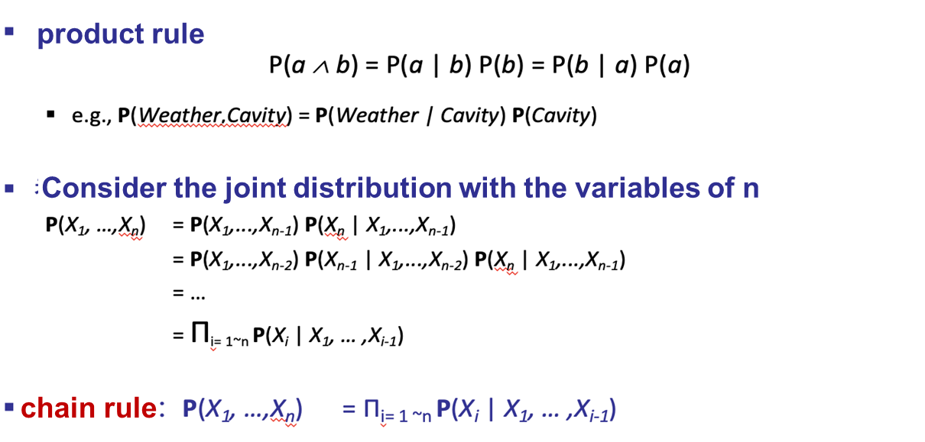
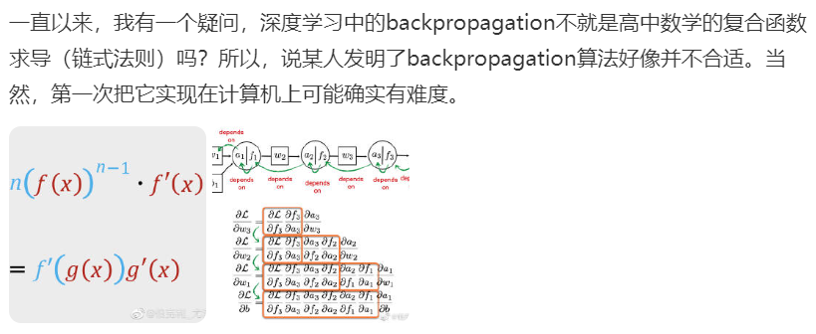
Law of multiplication, law of chains
新加坡国立大学校长青年教授，北京潞晨科技有限公司董事长尤洋老师（2021年4月入选亚洲福布斯30岁以下精英榜）
Notes:
标：乘法法则、链式法则

Slide 34
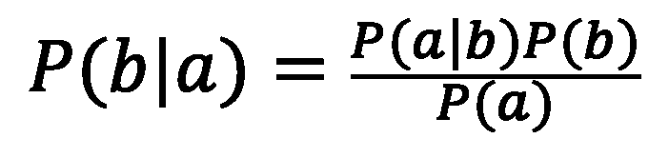
Bayes' Rule
According to the law of multiplication, the joint distribution can be expressed as follows:
Divide by P (a) to obtain Bayesian rule:
This is the basis of most AI systems that perform probabilistic inference
Notes:
标：贝叶斯规则
1.根据乘法法则，联合分布可以表⽰为
2.同时除以P(a)，得到贝叶斯规则:
3.这是⼤多数进⾏概率推理的⼈⼯智能系统的基础

Slide 35
Probability reasoning
Notes:
这里我们将讨论概率推理相关的话题

Slide 36
Probabilistic reasoning
Decision theory = probability theory + utility theory
The full probability distribution can answer any questions about the question domain, but:
The number of variables increases to the extent of unoperability
It is unnatural to specify probabilities for each possible world
Notes:
完全概率分布能够回答关于问题域的任何问题, 但是存在这样的两个问题, 首先是随着变量数目增多会增大到不可操作的程度.
其次为每个可能世界逐个指定概率是不可能的

Slide 37
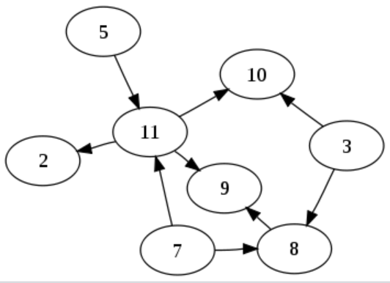
Probabilistic reasoning
A Bayesian network is a technique that describes a complex joint distribution using a simple local distribution (conditional probability)
01
a directed acyclic graph
02
can represent dependencies
between variables
03
can represent any fully
joint probability distribution
directed acyclic graph
Notes:
那么为了解决这两个问题, 我们采取贝叶斯网络. 贝叶斯网络是一种使用简单局部分布, 也就是条件概率, 来描述复杂联合分布的技术. 贝叶斯网络是一个有向无环图，也称之为图模型. 它是用于表示变量之间的依赖关系. 理论上来说, 它可以表示任何完全联合概率分布

Slide 38
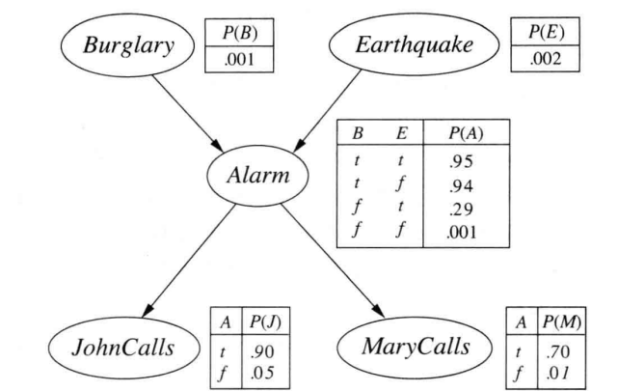
Probabilistic reasoning
An example of a Bayesian network:
The example in the picture is that an earthquake and thieves may trigger a home alarm. After hearing the alarm, neighbors John and Mary may call me.
Notes:
这里我们介绍一个贝叶斯网络的例子. 图中的例子是 地震和盗贼可能会引发家用报警器, 听到了报警器的声音之后, 邻居John和Mary可能会给我打电话. 图中的一个节点对应一个随机变量, 有向边表示的是连接的变量间的直接影响, 通过一个条件概率分布可以量化父结点对于该结点的影响 , 这就构成了一个条件概率表. 这样的网络拓扑反应了因果关系

Slide 39
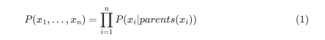
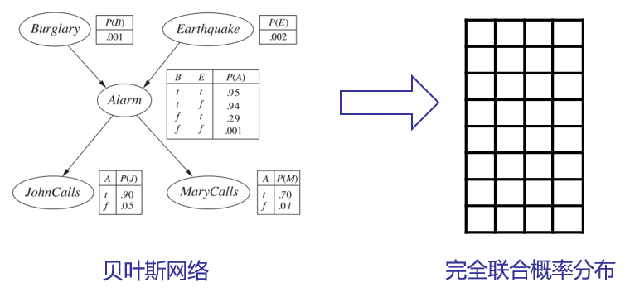
Probabilistic reasoning
Semantics of the Bayesian networks
The Bayesian network is a representation of the full joint probability
The fully joint probability distribution is defined by the product of the local conditional probability distributions
For example, in the example, the probability of both people calling you can be expressed
Notes:
在对于贝叶斯网络有个基本认识之后, 我们需要对于贝叶斯网络的语义有一个初步的了解. 贝叶斯网络是完全联合概率的一种表示. 完全联合概率分布由局部条件概率分布的乘积进行定义. 如下面的公式所示. 举个例子来说, 比如在刚才的例子中, 两个人都给你打电话的概率可以表示成这样的形式, 那么我们就可以计算出两个邻居都给你打电话的概率是0.00063

Slide 40
Probabilistic reasoning
Method for constructing a Bayesian network
First, we need to construct the nodes in the Bayesian network, and we need to choose a set of arranged random variables X_{i},…,X_{n}
Then, we construct edges in the Bayesian network, from nodes to, we perform such a step
First, we select the minimum set of parent nodes from the nodes before this node, where P(X|Parents(X_{i}))=P(X_{i}|X₁,…,X_{i-1})
Then insert an edge between the parent nodes and X_{i}
Finally we can get a conditional probability table P(X_{i} |Parents(X_{i})).
Notes:
然后我们介绍一下构造贝叶斯网络的方法. 首先, 我们需要构造贝叶斯网络中节点, 我们需要选择一组排好序的随机变量. 然后, 我们构造贝叶斯网络中的边, 遍历全部的节点, 我们执行这样的步骤:
首先从这个节点之前的节点选择父节点的最小集合, 然后在父节点和 之间插入一条边, 最后我们可以得到一个条件概率表.

Slide 41
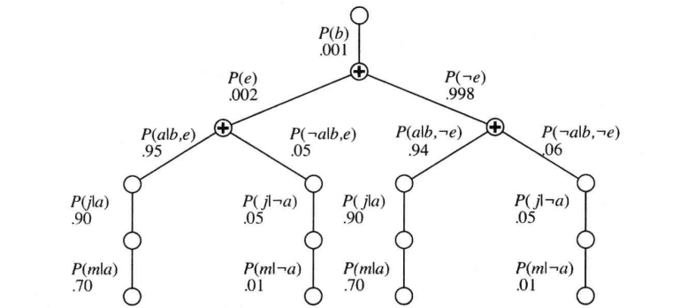
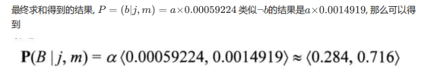
Probabilistic reasoning
To calculate this expression, we cycle through all the variables and then sum, and we can finally turn the formula into one such structure, multiply the values on each path, and sum at "+"
We can get the result of P= (b | j, m) =a*0.00059224 and P= (¬b | j, m) a*0.0014919
The values along each path in the Bayesian network are multiplied and then summed at the "+". It can be implemented in the form of “Normalization exponential function or Softmax function," used in deep learning classification tasks. The Softmax function is also referred to as a Bayesian classifier.
Notes:
为了计算这个表达式, 我们循环遍历所有的变量, 然后进行求和, 我们最终可以将这个式子变成一个这样的
结构, 将每条路径上的值相乘, 并且再“+”号处求和, 我们可以得到两个邻居都给你打电话的时候家里面遭到窃贼的值, 同样的也可以计算出没有遭遇切责的值, 将结果做一个softmax就可以得到: 在两个邻居都给你打电话的条件下，出现盗贼的概率大约是28.4%。

Slide 42
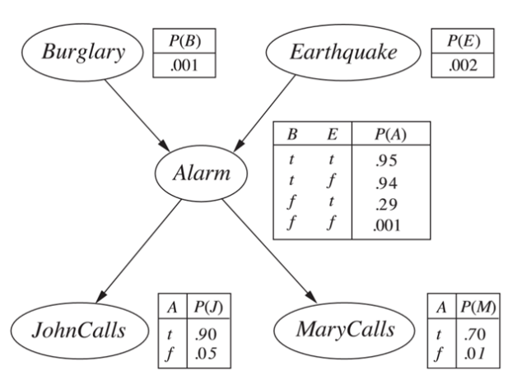
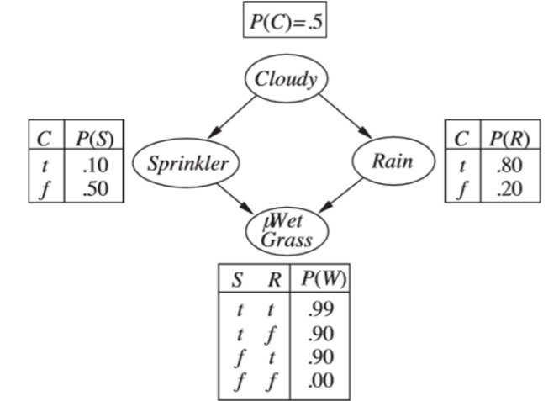
Single-connected and multi-connected networks
Single-connected network
Multi-connected network
1. there is at most one (undirected) path between any two nodes in the network
2. the time and space complexity of exact inference is linearly related to the network size
1. Worst case has exponential time and space complexity.
2. Bayesian network inference is #P-problem-strictly harder than NP-complete problem
Notes:
我们最终得到的网络可能有单连通网络和多联通网络两种形式. 对于单连通网络: 1. 网络中任意两个结点之间顶多只有一条(无向)路径 2. 精确推理的时间和空间复杂度与网络规模呈线性关系 对于多连通网络 1. 变量消元算法在最坏情况下具有指数量级的时间和空间复杂度。 2. 贝叶斯网络推理是#P难题-严格难于NP完全问题

Slide 43
Sample learning
Notes:
不确定性量化

Slide 44
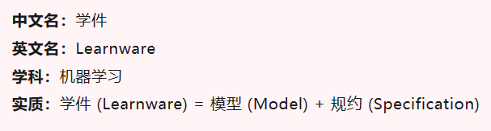
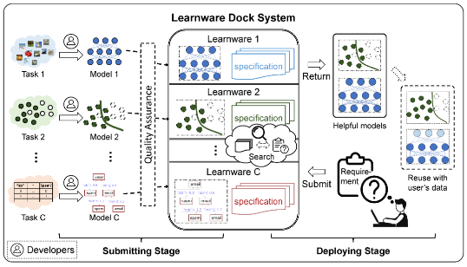
Brief description
This part focuses on a wide range of practical problems: we want an agent to learn from a set of input-outputs that can predict the output corresponding to new inputs.
For this agent, there are four improvement factors
Author：Zhou Zhihua
学者谈术语 | 学件 (qq.com)
Which part to improve on
What kind of priori knowledge does the agent have
How to represent data and components
the available feedback in learning
unsupervised learning, supervised learning, reinforcement learning
Notes:
这一部分的内容聚焦于一类实际应用非常广泛的问题: 我们希望一个智能体可以从一组“输入-输出”中学习能够预测新输入相对应的输出的函数。 对于这个智能体, 有四个改进因素 1. 改进哪个部件 2. agent具备什么样的先验知识 3. 如何表示数据和组件 4. 学习中可用的反馈是什么. 其中对于学习可用的反馈主要有三种, 分别是无监督学习, 监督学习和强化学习.
对于无监督学习, 我们没有来自外部环境的直接反馈（输出值），我们需要自行组织学习的输入, 这需要我们挖掘数据中的隐含规律.
对于监督学习.对每一个输入模式都有一个正确的目标输出, 那么外部环境的反馈需要告知agent的期望输出是什么，或当前输出是否正确, 通过这样的反馈机制 我们可以从一组输入－输出的实例数据集中学习出一个函数, 或者说是一组模型参数. 那么当新的数据到来时，可以根据这个函数预测结果.
对于强化学习, 我们主要的反馈信息是奖励和惩罚组成的序列, 以及奖惩之前的哪些动作需要为结果负主要责任

Slide 45
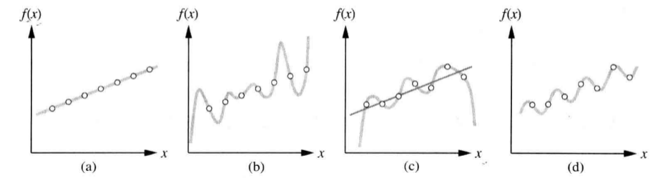
Supervised learning
1.Supervised learning
The task of supervised learning is to give a training set consisting of N input-output pair samples (x₁ , y₁) , (x₂ , y₂) , … , (x_{i} , y_{i}), where y_{i}=f(x_{i}). The target of supervised learning is to get a function h(x) that approximates the true function f.
In supervised learning, if the hypothesis function h can perfectly fit certain data, we refer to h as consistent with f.
Different h may fit the data to varying degrees and have different complexity, as shown in the figure: Although each function perfectly fits the points, the level of complexity is clearly different.
Our hypothesis function h corresponds to a hypothesis space H. So how to select from multiple consistent hypotheses within the hypothesis space?
Select the simplest one! This principle is known as Occam's Razor (don't artificially complicate things; don’t unnecessarily multiply entities)
2. Examples
Notes:
首先我们介绍一下监督学习的基本概念, 对于监督学习, 他的的任务是: 给定由N个“输入-输出”对样例组成的训练集 . 其中，每个y由未知函数y=f(x) 生成。监督学习的湖底就是发现一个函数h ,它逼近真实函数f 。 其中, x和y可以是任何形式的值, 比如在分类任务中, y就是一些离散的值, 比如我们需要对图片分类, 识别这是猫还是狗还是两者都不是; 在回归任务中, 我们则需要去预测比如明天的气温具体是多少度. 在监督学习中, 如果我们的函数 h能够完美拟合某些数据, 我们称 h是一致的. 不同的假设可能拟合的程度不一样, 复杂程度也不同, 如下图所示: 虽然每个函数都完美拟合了数据点, 但是显然复杂的程度是不同的

Slide 46
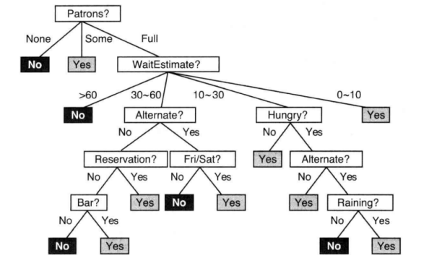
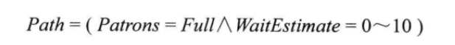
Supervised learning
1.Decision tree
1.Alternate: Is there a alternative？
2.Bar: The waiting area comfortable or not？
3.Fri/Sat: Friday or Saturday
4.Hungry: Are we hungry
5.Patrons: Number of the customers(None, Some, Full)
6.Price: the price range of the restaurant ($,$$, $$$)
7.Raining: Is raining?
8.Reservation: Have we reserved?
9.Type: (French, Italian, Thai, Burger)
10.WaitEstimate（Estimated wait time）: (0-10, 10-30, 30-60, >60)
Notes:
首先介绍决策树的基本概念. 决策树将从一组训练数据中学习到的函数被表示为一棵树 决策树通过把实例从根节点排列到某个叶子节点来分类实例： 树上的每一个节点指定了对实例的某个属性的测试 节点的每一个后继分支对应于该属性的一个可能值。 叶子节点即为实例所属的分类. 举个例子来说, 我们要决定是否在一个餐厅里面等餐, 我们这里列出全部的属性, 比如我们是否有一个替代的选项? 等待的区域是否舒适, 现在是不是周五或者周六, 我们是否饥饿等等一共十个属性, 这些属性可能会影响我们最终的决策. 我们则可以通过这些属性构造出一棵决策树,比如最右边的路径可以表示为右上角的公式的形式.

Slide 47
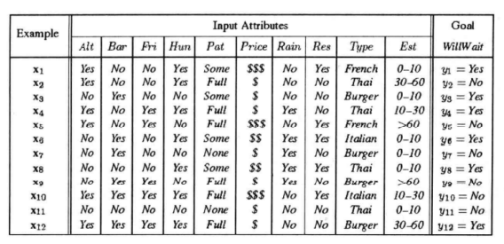
Supervised learning
If there are both positive and negative samples left, the corresponding result can be output.
If there are both positive and negative samples left, the best attribute is selected to continue the split.
If there are no samples left, then no samples are observed for the combination of the attributes, and the largest classification in the parent node can be returned.
If there are both positive and negative samples left, and no attributes are available, then return the classification with the most samples left.
Notes:
那么如何构造决策树呢. 假设, 对于刚刚提到的这些属性, 我们收集到了一些样例, 其中, 有每个属性具体的值,以及对应 的最终的结果. 在构造决策树的时候, 总是优先选择重要的属性, 从而将问题分解为更小的问题, 以便于进行递归求解. 在递归中考虑四种情况: 1. 如果剩下的都是正例或者负例, 则可以输出对应的结果 2. 如果剩下的既有正样本又有负样本, 则选择最好的属性继续分裂 3. 如果没有剩下任何样例, 则对于这个属性的组合没有观察到任何样例, 可以返回父节点中 最多的分类 4. 如果剩下的既有正样本又有负样本, 且没有属性可用了, 则返回剩余样本中最多的分类.

Slide 48
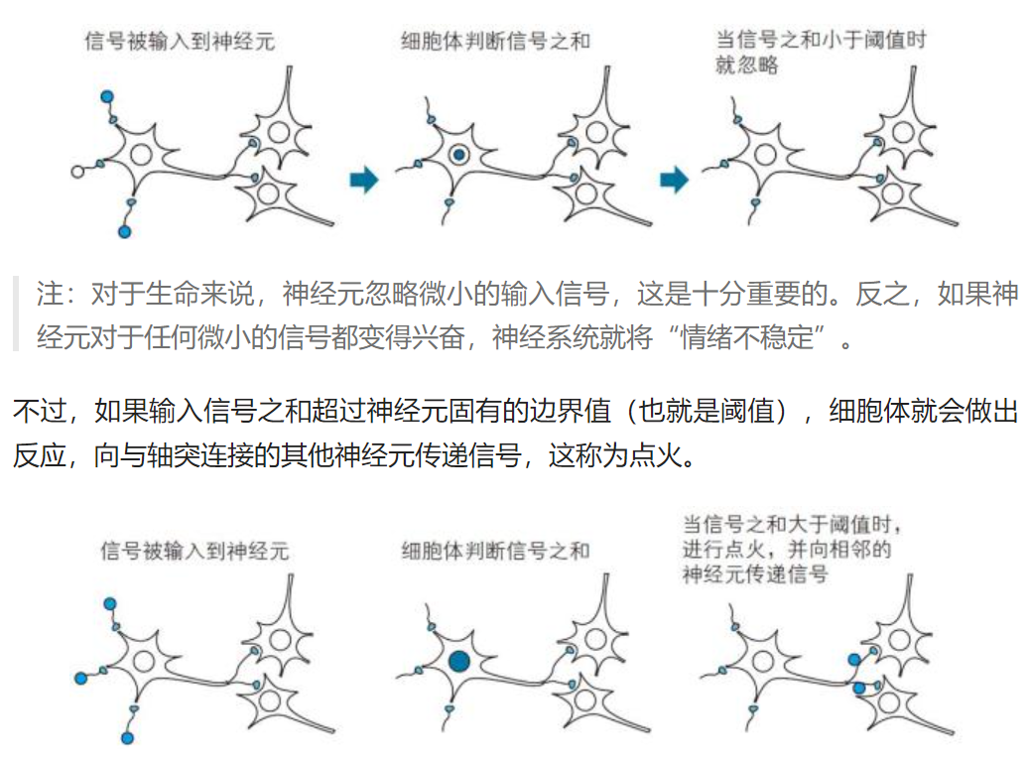
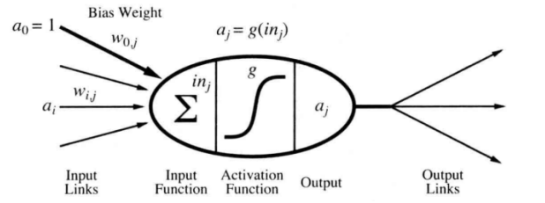
Supervised learning
1. artificial neural network
Notes:
另一类曾经被广受重视的监督学习是人工神经网络。人工神经网络(ANN) ，也称为神经网络或模拟神经网络(SNN)，是机器学习的子集，并且是深度学习算法的核心（卷积神经网络（CNN或ConvNet）是一类深度神经网络）。 其名称和结构是受人类大脑的启发，模仿了生物神经元信号相互传递的方式，是一种模仿生物神经网络（动物的中枢神经系统，特别是大脑）的结构和功能的数学模型或计算模型，用于对函数进行估计或近似。大多数情况下人工神经网络能在外界信息的基础上改变内部结构，是一种自适应系统，通俗地讲就是具备学习功能。
如图所示, 这是一个简单的神经元的简单数学模型。 包括输入, 输入函数, 激活函数以及输出, 通过输入函数求和, 以及激活函数激活, 最终可以得到输出. 粗略地说，当输入的线性组合超过某个（硬或软）阈值时，神经元“点火”。一个神经网络是由一组单元连接而成：网络的性质由它的拓扑和神经元的性质确 定。
在以后我们的群体智能部分介绍中，还会讲到它。
https://www.toutiao.com/article/6688175496821211662/
https://m.ituring.com.cn/book/tupubarticle/28234

Slide 49
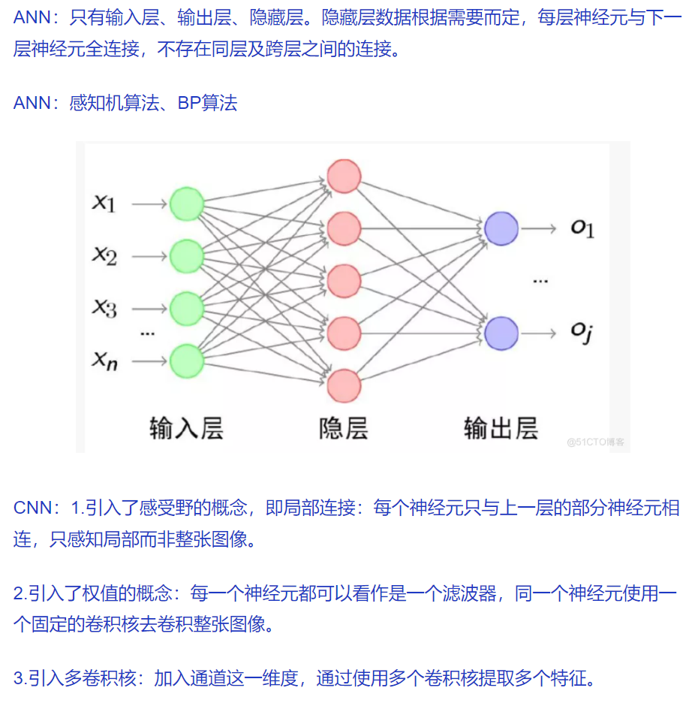
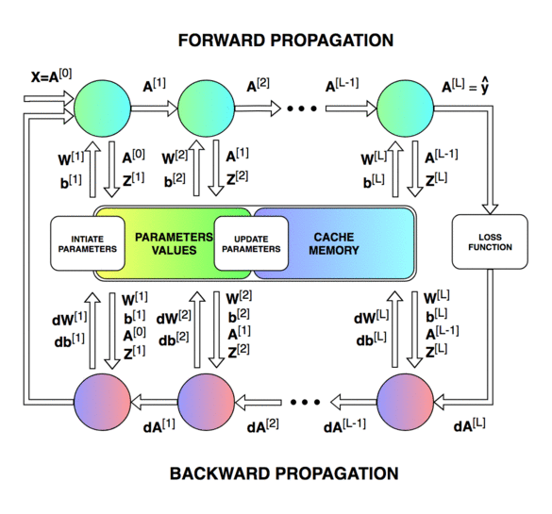
Supervised learning
1. artificial neural network
Artificial neural network models have long been troubled by the problem of training deep parameters. It wasn't until decades after the inception of artificial neural network models that researchers proposed the backpropagation algorithm.
Forward Propagation and Backpropagation
《动手深度学习》https://zh.d2l.ai/chapter_multilayer-perceptrons/backprop.html
Notes:
这是人工神经网络与（深度学习范畴下）卷积神经网络的区别。
https://blog.51cto.com/u_15567091/5234874

Slide 50
Natural language processing
Notes:
下面介绍自然语言处理。

Slide 51

natural language processing
Information retrieval tasks: text classification, information retrieval, and information extraction
Language model
Formal languages, such as Java and Python, have language models with precise definitions.
In Python, "print(2+2)" is a legal program, while "2)+(2 print" is not. The number of legal programs is infinite, but we can describe it through grammar.
Different in natural language
Cannot be described as a definite set of statements
Natural language also has ambiguities
A model of natural language is an approximation of natural language
Turing test: When the tester and the person being tested (a person and a machine) are separated, the tester asks random questions to the person being tested through some device (such as a keyboard). After multiple tests, if the machine allows each tester to make more than 30% misjudgments on average, then the machine is considered to have human intelligence.
Notes:
人类因为具有语言的能力而区别于其他物种。虽然黑猩猩、海豚等动物也能掌握数百个符号构成的词汇，但是只有人类能够适用离散的符号，可靠地传递大量信息。
随着人工智能的发展，人类开始想要智能体能够处理自然语言。因为，我们希望智能体能与人类交流，也希望智能体能从人类的自然语言中获取信息。
图灵测试的提出，也是基于语言的（有同学能说出图灵测试的内容吗？图灵提出，测试者与被测试者（一个人和一台机器）隔开的情况下，通过一些装置（如键盘）向被测试者随意提问。 进行多次测试后，如果机器让平均每个参与者做出超过30%的误判，那么这台机器就通过了测试，并被认为具有人类智能）。在这个定义下，大家感觉图灵测试是否已经过时？
---
目前，互联网上已有超过万亿数量的信息网页，几乎所有的这些页面都是用自然语言描述的。Agent想要获取知识，就需要理解（至少部分理解）人们所使用的具有歧义的、杂乱无章的语言。
对于这个需求，我们考虑的就是一个“信息查找任务”的问题。这又涉及了三个子问题：文本分类、信息检索和信息抽取。
解决这些问题，有个共同的需要，就是要采用语言模型。这个模型是用来预测语言表达的概率分布情况的。
所有的形式语言，如Java和Python等编程语言，都有精确确定义的语言模型。在Python语言中，“print(2+2)” 是一段合法的程序，而“2)+(2 print”则不是。合法的程序的数目虽然是无限的, 但是我们可以通过语法来 描述.
但是在自然语言中却有一些不同，它不能描述为一个确定的语句的集合. 一般认为"Not to do"是符合语法的, "To not do"是错误的, 但是这并不是绝对性的错误. 因此, 通过概率分布来定义自然语言模型是更加有效的.
自然语言也存在歧义. 同一句话在不同的语境中会有不同的含义, 对一个句子的解释应该使用多个意义上的概率分布
自然语言的模型是对自然语言的近似. 由于自然语言在不断的发展中, 不断的有新的单词和语句被制造出来, 所以只能做到近似, 而不能完全的模拟

Slide 52
natural language processing
N-gram character model
A sequence of length n we call an n-gram. The probability distribution over a sequence of n characters becomes the n-gram character model.
Smoothing of the n-gram model
For adjusting the probability of low-frequency counts, this process needs to be smoothed. The classical smoothing methods are: Laplace smoothing, regression model, linear interpolation smoothing, etc.
N-gram word model
The probability distribution over a sequence of n characters becomes the n-gram word model.
1-gram: logical are as are confusion a may right tries agent goal the was...
2-gram: systems are very similar computational approach would be represented...
3-gram: planning and scheduling are integrated the success of naive bayes model is...
Notes:
自然语言处理中需要注意以下概念：
首先介绍n元字符模型. 长度为n的序列我们称之为n元组. 一个n个字符序列上的概率分布就称为n元组字符模型. 假设我们有一个包含100 个字符的三元模型, 那么他就有100万个参数, 显然非常的复杂, 因此对于参数的估计我们可以通过从语料库中统计得到. 得到 了n元字符模型, 一个最简单的任务就是语言识别, 计算机可以很轻松的识别出来对应的短文本是英语还是德 语. 同时, 这个模型还可以完成诸如拼写纠错, 体裁分类, 命名实体识别等任务.
但是对于一个句子“The program issues an http request” 其中http不在英语的语料库中, 则很直接采用n元 字符模型不能够识别出来这是英语. 因此需要对于调整低频计数的概率, 这个过程就要平滑. 经典的平滑方 法有: 拉普拉斯平滑, 回退模型, 线性插值平滑等.
还有一种是n元单词模型。n元单词模型显然比n元字符模型复杂的多, 原因在于单词的集合远远比字符的集合大, 一般一个语言的符 号不会超过100个, 但是单词的数量往往不可计数. 同时还有未知的单词和数字和邮箱等特殊的组合. 那么这么复杂的模型到底能带来什么好处呢, 在一个小的文本中建立单词模型, 我们可以从123元的单词 模型的随机取样.显然三元和二元的表达远比一元的效果更好

Slide 53
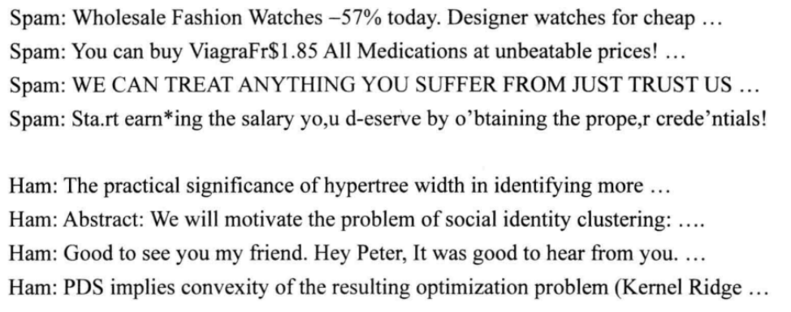
natural language processing
Text classification
Text classification task: given a text, determine which category it belongs to in a predefined set of categories. Example: Language recognition and genre classification, sentiment analysis and spam detection.
An example for spam detection:
Notes:
语言模型之后，现在我们详细介绍文本分类任务。
给定某个文本，我们需要判断它属于预定义类别集合中的哪个类别。
语言识别 和体裁分类都是文本分类的例子，情感分析（判断电影或产品评论是积极的还是消极的）和垃圾邮件检 测（判断电子邮件信息是垃圾邮件或非垃圾邮件)也是文本分类。
我们可以将垃圾邮件检测看作一种监督 学习问题。训练集很容易得到：正例（垃圾邮件）在垃圾邮件文件夹里，负例(非垃圾邮件)在收件箱里。 下面是一些摘录样本, 其中spam是垃圾邮件, ham是正常邮件. 从这里面我们可以发现“for cheap”和“you can buy”等n元词序列很像是垃圾邮件的特征 还有"you deserve"等也可以是垃圾邮件的特征.
对于文本分类任务, 我们有两种方法 一种是基于语言模型的方法, 通过训练得到一个垃圾邮件的n元语言模型以及正常邮件的n元语言模型. 然后使用贝叶斯规则对其分类. 另外一种是机器学习的方法, 通过将n元组作为特征,使用机器学习算法进行分类任务, 只要确定了垃圾邮 件的特征集, 就可以使用任务监督学习的技术, 完成分类

Slide 54
natural language processing
Information retrieval
The task of Information retrieval (IR) is to find documents that are relevant to the user's information needs.
The feature of the IR system is :
Document collections.
A query described using a query language.
Result collection.
Presentation of the result collection.
Notes:
信息检索(Information retrieval, IR)的任务是寻找与用户的信息需求相关的文档。
网上的搜索引擎就是 一个众所周知的信息检索系统的例子。用户将类似[AI book]的查询信息输入到搜索引擎，就能得到相关 的网页的列表。
一个信息检索系统具有如下特征：
1. 文档集合。每个系统都必须确定其需要处理的文档：一个段落文本、一页文本还是多页文本。
2. 使用查询语言描述的查询。查询描述了用户想知道的内容。查询语言可以是一个单词列表，如[AI book];可以是一个必须连续出现的单词短语，如[“AI book”]
3. 结果集合。该集合是文档集合的子集，包含了IR系统判断的与查询相关的那部分文档。
4. 结果集合的展示。结果集合可以简单地用有序的文档标题列表来展示，也可以采取复杂的展示方法。当前，信息检索系统使用一种简单的基于词袋的语言模型，它在处理大规模文本语料时，在召回率和准确率上 也有好的表现。在万维网语料上，链接分析算法能够提升性能。
信息检索也是我们用户交互技术中的重点内容，以后会专门介绍。

Slide 55
natural language processing
Information extraction
Information extraction is a process of browsing text to obtain specific classes of objects and the relationships between objects.
Typical tasks include extracting address instance information from web pages to obtain the contents of database fields such as street names, city names, state names, and zip codes, and extracting storm information from weather reports to obtain the contents of database fields such as temperature, wind speed, and rainfall.
Notes:
信息抽取是一个通过浏览文本获取特定类别的对象以及对象之间的关系的过程。
其典型的任务包括，从网页中抽取地址实例信息，获取街名、城市名、州名以及邮政编码等数据库字段的内容；从天气报道中抽取暴风雨信息，获取温度、风速以及降雨量等数据库字段的内容。在受限的领域内，信息抽取可以达到高的准确率。而在更一般的领域内，则需要更复杂的语言模型和更复杂的学习技术。
目前自然语言处理技术大放光彩。除了机器翻译、语音识别外，还有哪些应用？

Slide 56
Perception
Notes:
下面介绍感知（智能）。一种说法，我们正从感知智能时代迈入认知智能时代。有同学听说过吗？能否讲讲其中区别。

Slide 57
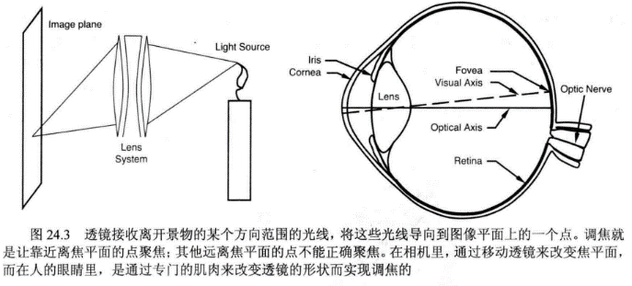
Perception
Perception provides Agents with information about the world they live in by interpreting the responses of sensors. Sensors measure some aspect of the environment in the form of input that can be used in Agent programs. A sensor can be as simple as a switch that outputs a bit to indicate on or off. Some robots can perform active sensing, meaning that they emit a signal, such as a radar signal or ultrasound, and then sense the signal reflected back from the environment. Here, we will focus on one form of sensing: vision.
Corresponding to visual perception, there are three main image processing techniques: edge detection, texture analysis, and optical flow computation, which support agents in image segmentation.
Notes:
好的，我们看看人工智能中的感知任务是什么。
感知是通过解释传感器的响应而为Agent提供它们所处的世界的信息。
传感器作为Agent程序的输入，提供环境测量信息。传感器可以是一个简单的开关（比如输出一个比特表示开或者关），也可以是复杂如人眼一样的部件。
对于机器人来说，有些机器人可以进行主动传感，也就是说它们发射出一个信号，比如雷达信号或超声波，然后感知从环境中反射回来的信号。因此可以看到，人工智能研究其实通常面临跨学科的交叉知识的学习，尤其是物理知识。像去年很火的扩散模型，思路就来源于热力学，而有些学习模型更是直接结合物理模型构建的。
这里, 我们将重点讨论一种感知形态：视觉感知
对应视觉感知，主要包括三种图像处理技术, 分别是：边缘检测,纹理分析以及光流计算, 从而支持agent进行图像分割。

Slide 58
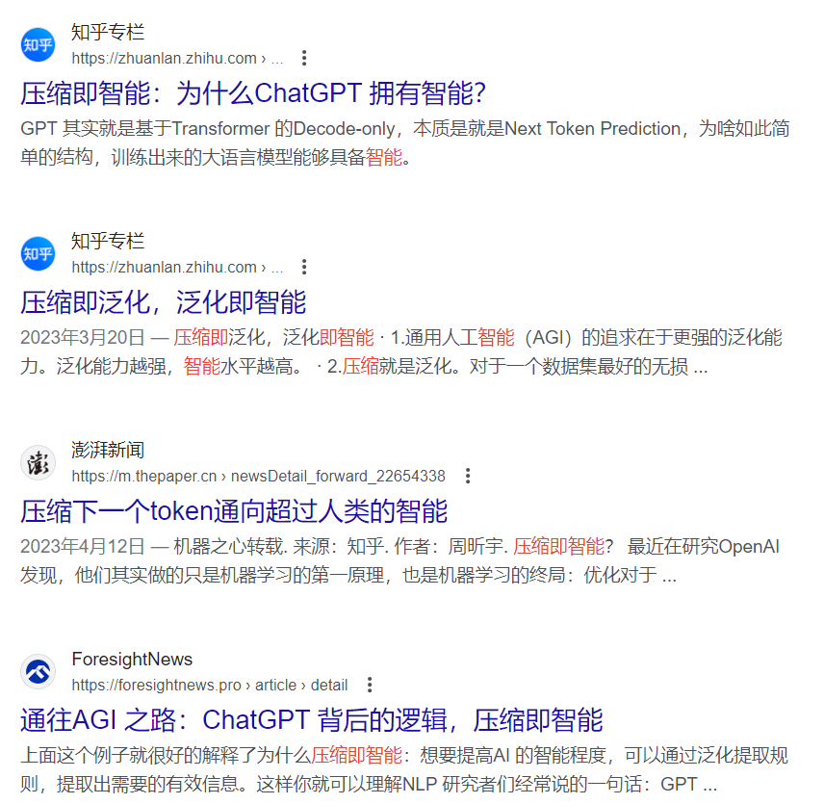
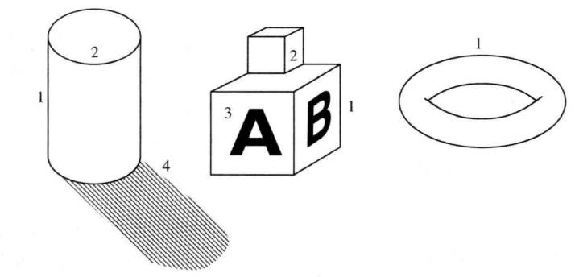
Perception
Edge detection
Eges are straight or curved segments in an image with "significant" changes in the image brightness through the edges. The goal of edge detection is to abstract a large, megabytes byte of image data to form a more compact and abstract representation
Notes:
边缘检测
边缘是图像中的直线或曲线段，穿过边缘的图像亮度有“显著的”变化。
边缘检测的目标是根据大量的、成兆字节的图像数据进行抽象，形成更紧凑、更抽象的表示方式。
边缘检测可以获得图像中的各种轮廓，在我们的项目中也有实际的应用。

Slide 59


Perception
Texture and optic flow
Texture, refers to patterns that recur on the surface space and can be perceived visually.
Optical flow, describes a video sequence in which an object in the image is moving or our camera is moving relative to the object, and the resulting apparent motion in the image is called optical flow.
Notes:
纹理, 它指的是在表面空间上重复出现的、能够通过视觉感觉到的模式。
纹理的实例包括建筑物上窗户的 模式、汗衫上的针脚、美洲豹皮肤上的花斑等. 在不同的光照下, 纹理一般是不变的, 这使得纹理成为了识别物理目标的重要依据。对应了纹理分析技术。
光流则描述的是一个视频序列, 图像中的物体在运动或是我们的镜头在相对物体运动时，由此会引起的图像 中的明显的运动，我们称之为光流。 如图所示, 最右边图是对应一帧到另一帧像素的位移。计算这个光流通常是一个重要任务。

Slide 60

Perception
Image segmentation
Segmentation refers to the process of splitting an image into several regions based on the similarity of the pixels. The basic idea is as follows: Each image pixel can be associated with certain visual features, such as brightness, color, and texture. In an object, or in a separate part of it, these properties vary relatively little, and one or more of these properties typically vary greatly when crossing the boundary between objects.
Two methods are available for image segmentation, one devoted to detecting the boundaries of these regions, while the other focuses to detecting the region itself.
In most projects, image segmentation and edge detection are used simultaneously.
The ultimate goal is to achieve image segmentation.
Notes:
图像分割是指基于像素点的相似性将图像分解成若干区域的过程。
其基本思想如下：每个图像像素都可以关 联某些视觉特性，诸如亮度、色彩和纹理。在一个物体中，或者是它的单独一部分中，这些属性的变化 相对非常小，而穿过物体之间的边界时，典型情况下这些属性中的一个或多个会出现较大的变化。
有两 种方法可用于图像分割，一种主要致力于检测这些区域的边界，而另一种则致力于检测出区域本身。 如图所示(a)是原始图像, (b)是边缘轮廓(c)和(d)则是对应不同精细程度的区域分割,(c)更加精细,(d)更加粗糙。
我们项目中图像分割与边缘检测是同时用到的。最终目标是完成图像分割。

Slide 61

Perception
Object recognition based on the appearance
Appearance refers to the situation at which an object looks like. Some objects, such as baseball, change little in appearance: in most cases they look much the same. Based on this, we can calculate some features describing the images containing these objects, and then train the classifier accordingly.
Other objects, such as houses, generally vary greatly.
During the recognition, various challenges also arise, such as occlusion, different orientations, deformation, perspective, and so on.
Notes:
这是一个典型的应用研究：基于外观的目标识别。
外观指的是一个物体看上去的情况。一些物体类（比如说棒球）在外观上会变化很小：在大部分的情形下 这类物体看起来基本一样。
基于此，我们可以计算一些描述包含这些物体的图像的特征，然后据此训练 出分类器，对物体进行分类和识别。
其他类别的物体—如房子，它们的变化一般很大。如一所房子可能具有不同的大小，颜色或者形状，甚 至在不同的角度来看它也可能是不同的。一个理念是物体一般由些局部部分组成，而物体的变化主要是 这些局部部分相互之间的移动导致的。我们可以通过检测局部的特征，来检测整体是否存在， 而不必关心各个部分的位置。
在识别的过程中, 还存在这种各样的问题, 如遮挡, 不同的朝向, 形变, 透视等等。这些问题会导致图像的特征被影响. 但是无论物体怎么变化, 总会在图像中表现出某些固定的结构.
不过，我们现在的物体识别算法已经可以达到非常好的效果, 如下图所示:
这种进步，是前几年吸引大量人才涌入人工智能领域的关键。包括现在还有大量的研究人员在研究计算机视觉相关问题。像感知中的三维重建、基于结构的物体识别等，我们学院的张林老师、梁爽老师就在做长期深入研究。

Slide 62

Thank YOU
Embodied Intelligence (Embodied Artificial Intelligence, Embodied Intelligence, Embodied AI) refers to the creation of intelligent agents through the integration of software and hardware components.
https://weibo.com/ttarticle/p/show?id=2309404871275821793925
Notes:
大家学习人工智能也不要忽视机器人学，以及机器人学所研究的硬件对象。其次，正如我们基于参考书的基础概念这部分教学内容开始所提到的，大家也不要忽视人工智能的发展伦理、数理基础，以及未来动态。
人工智能的发展伦理方面：要关注信息安全、隐私保护、机器人权利、公平与偏见等议题。
人工智能的数理基础方面：要注意到一些数学异议，比如图灵和哥德尔证明了某些数学问题原则上是不能用形式系统解决的（哥德尔不完全性定理）。甚至，也要注意到一些物理原理（海森堡测不准原理）：一个微观粒子的某些物理量（如位置和动量，或方位角与动量矩，还有时间和能量等），不可能同时具有确定的数值，其中一个量越确定，另一个量的不确定程度就越大。薛定谔的猫就是讲这个问题。这些异议或原理，就是我们的科学边界，大家都看过三体吧。高水平的人工智能研究最终都要触碰科学边界（一个可能例子：就好比图灵测试已经被触碰）。另外大家也要广泛地关注存在于各个学科（自然科学方面）的第一性原理知识，比如能量守恒，要在未来深入的科研中将自己的研究与各类第一性原理反复印证。大家思考下为什么我们把数学的定理说成异议，海森堡测不准原理说成是原理？
人工智能的未来动态方面：要关注可解释性、安全性（比如智能体的安全保护）、如何衡量人工智能（图灵测试似乎已经过时）。
大家能否探讨一下：我们在沿着正确的方向前进吗？
目前《人工智能：现代方法》第四版中文版于近期问世，一篇Stuart Russell 教授的专访大家可以课后看看。最新第四版是两位作者把近十年 AI 进展，尤其是深度学习所带来的影响纳入整体框架后给出的最新阐释，体现了两位大师对人工智能趋势和学科体系发展的洞见。大家注意：《人工智能：现代方法》第四版有一个重要的更新，那就是不再假设 AI 系统或智能体拥有固定的目标。
对此作者是这样解释的：目标其实是一件非常复杂的事情。例如我说午饭想买个橙子，这可以是一个目标，对吧？在日常语境中，目标被视为某种可以被实现的东西，一旦实现了，事情就完结了。但在哲学与经济学定义的理性选择理论中，其实并不存在这样的目标，我们有的是对各种可能的未来的偏好或排序，每一种可能的未来都从现在一直延伸到时间的尽头，里面包含了宇宙中的所有。我想，这是对目标、对人类真正想要什么的一种更复杂、更深远的理解。
https://weibo.com/ttarticle/p/show?id=2309404871275821793925

